Slide 1
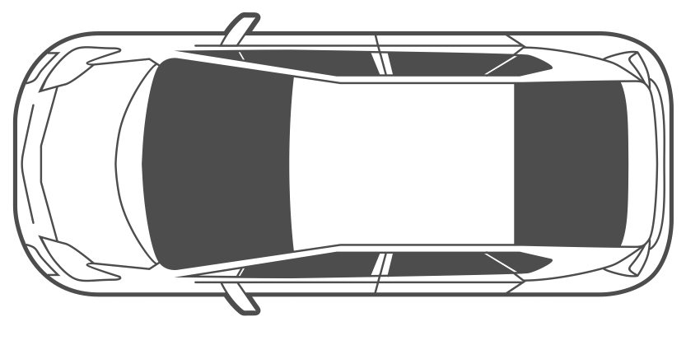
Charging Bay 1
Charging Bay 2
Charging Bay N
EV Charging Station
EV Charging Station
EV Charging Station
Wind Turbine Generator
…
AC/DC
…
Solar PV (MPPT)
DC/DC
Battery Swapping Station
Battery Swapping Station
…
Battery Swapping Station
Grid
Inverter
…
…
…
DB
DB
DB
Auxiliary Loads
…
…
…
FB
FB
FB
Bidirectional DC/DC
Battery Storage
Battery Storage
Battery Storage
DC-Bus
…
Charging System
BESS 1
BESS 2
BESS N

Slide 2
Distribution
Network
Of Prosumers
P₁
Inverter
X₁
C₁
M₁
Substation
P₂
Inverter
DSO\Grid
C₂
X₂
M₂
…
X_{n}
P_{n}
Inverter
C_{n}
M_{n}

Slide 3
Distribution Network Of Prosumers and Consumers
Prosumers
X₁
Consumers
Inverter
P₁
M_{p1}
M_{c1}
Substation
X₂
Inverter
DSO\Grid
P₂
M_{p2}
M_{c2}
…
X_{n}
Inverter
P_{n}
M_{pn}
M_{cn}

Slide 4

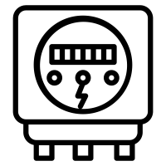
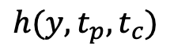
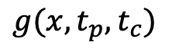
Distribution Network Of Prosumers and Consumers
Prosumers
X₁
Inverter
$$g(x,t_{p},t_{c})$$
P₁
M_{p1}
P2P Broker
Substation
X₂
Prosumer P
Inverter
DSO\Grid
M_{p2}
…
X_{n}
Inverter
$$h(y,t_{p},t_{c})$$
P_{n}
Consumer C
M_{pn}

Slide 5
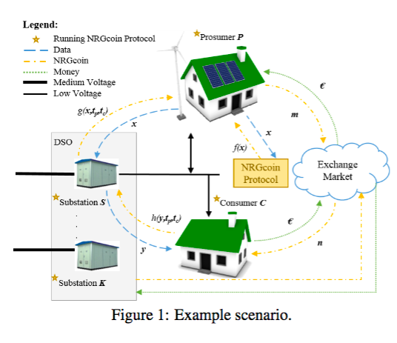
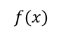
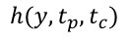
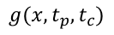
Prosumer P
$$g(x,t_{p},t_{c})$$
$
DSO
x
m
x
$$f(x)$$
Exchange Market
NRG Coin Protocol
Substation S
$$h(y,t_{p},t_{c})$$
n
$
Substation K
y
Consumer C
S,K,P,C : Running NRGCoin Protocol
Data
NRGCoin
Money

Slide 6
450
1990
2017
2020
350
2030
Million Metric Tons of CO₂
40% Below 1990
250
150
2050
80% Below 1990
50
Fig.1: Growth of Clean-Tech in the Energy Sector has reduced and will continue to reduce our carbon foot print. These technologies are leveraging resources management, government regulations and demand management to achieve these results. (Source: California Air Resources Board [CARB])

Slide 7
$
Energy Market
$
Grid
$
EV Charging Station
Inverter
P₁
C₁
M₁

